Slide 1
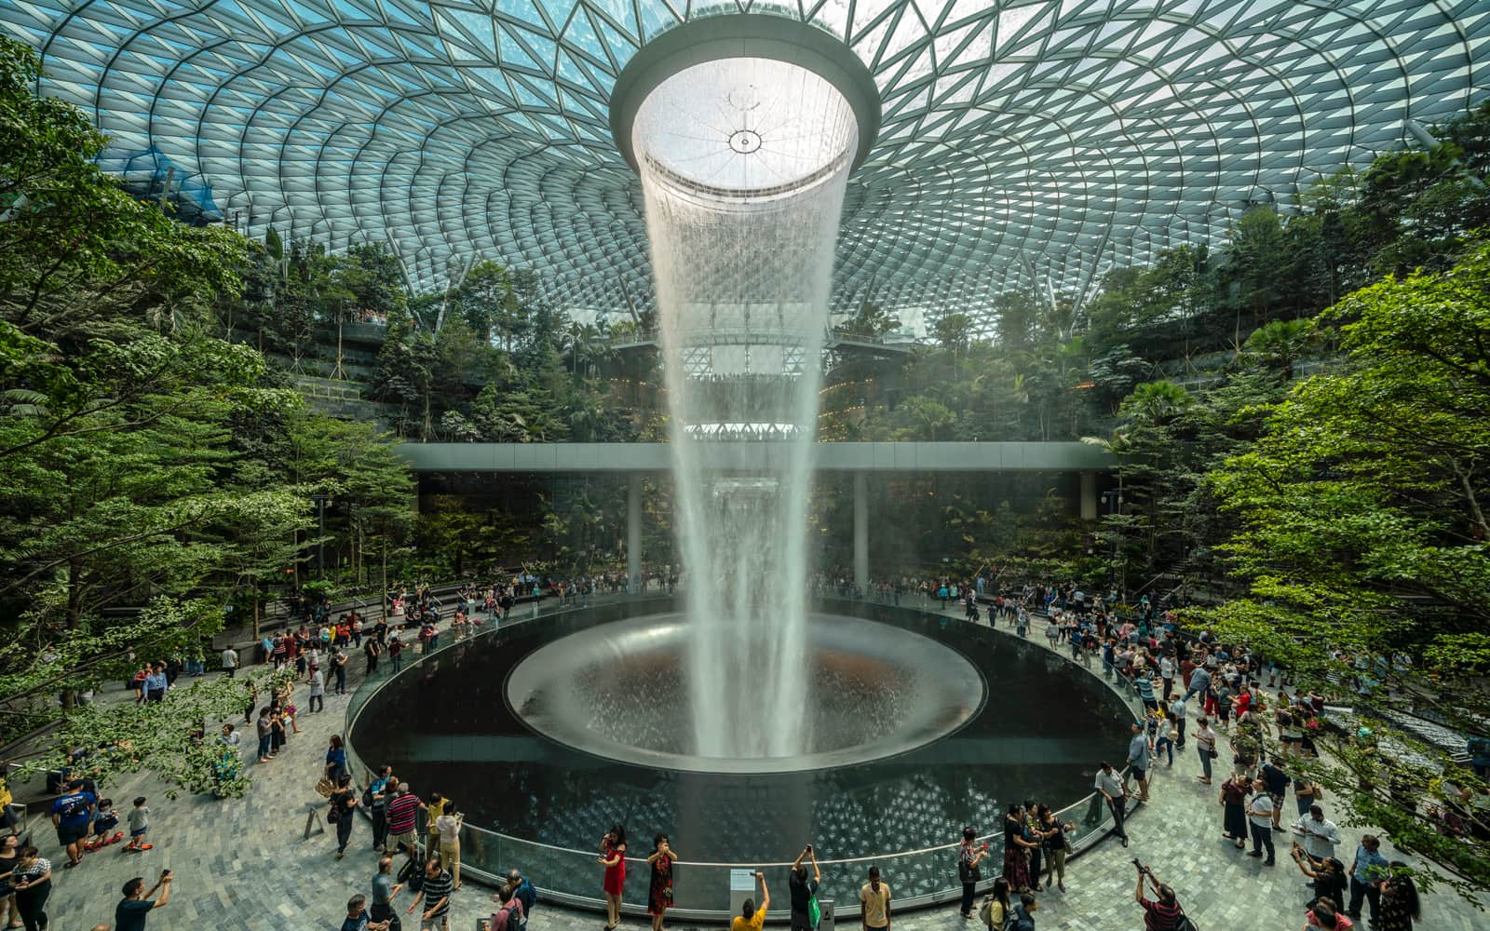
Greenhouse Cyber-Physical System
By
Abhilasha Mohapatra, Reddi Ashish, Vidwaan Krishnan Siddharth

Slide 2

Table of Contents
Introduction
Greenhouse System Overview & Components
UPAAL Model & Control Flow
PLC Code Mapping & Execution Cycle
Python Implementation
Attack Methodology
Detection Mechanisms
Conclusions

Slide 3
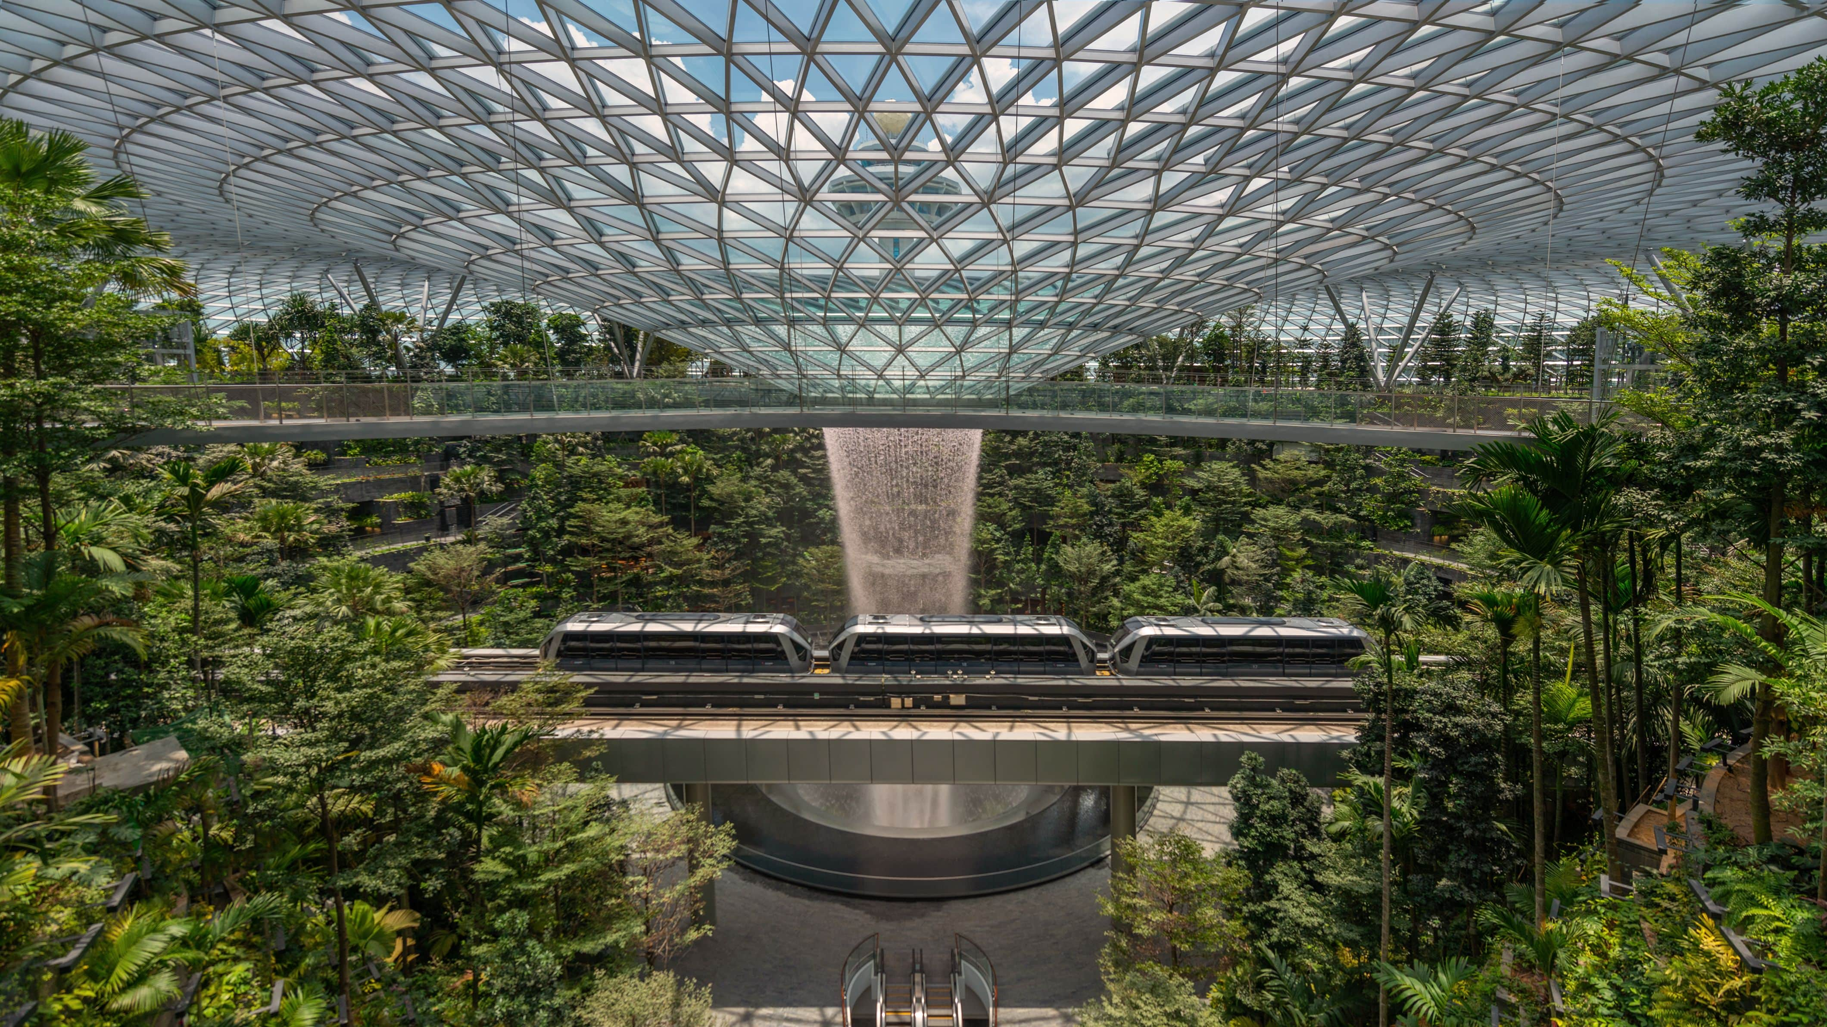
Introduction
A Greenhouse is a controlled space that creates the right conditions for plants by regulating temperature, humidity, light, water, and CO₂ levels. It allows crops to thrive even when outside conditions are not suitable.
Main Benefits of a Greenhouse:
Extend the growing season year-round
Shield plants from harsh weather conditions
Increase crop yield and quality
Support growth of plants outside their natural habitat
For our project, we designed a smart greenhouse simulation inspired by the Changi Jewel Airport indoor gardens, where advanced technology helps maintain a balanced environment. This simulation shows how automation and monitoring can make greenhouses more reliable, efficient, and sustainable.

Slide 4

Greenhouse System Overview & Components
System Architecture
Sensors: Temperature, Humidity, Light, Water Level
Controllers (PLCs):
PLC1 – Monitoring & Decision (collects sensor data, alerts)
PLC2 – Irrigation Control (moisture levels, pump and drain)
PLC3 – Climate Control (temperature level, heater and cooler)
PLC4 – Lighting Control (artificial light intensity and shadow shutters)
PLC5 – CO₂ Control (regulates concentration for plant growth)
Actuators: pumps, drains, heaters, coolers, shutters, lamps, CO₂ pumps and vents
Key Features
Closed-loop feedback between sensors & controllers
Automated environmental adjustments for optimal crop growth
Cyber-Physical integration allows simulation & attack/detection testing

Slide 5
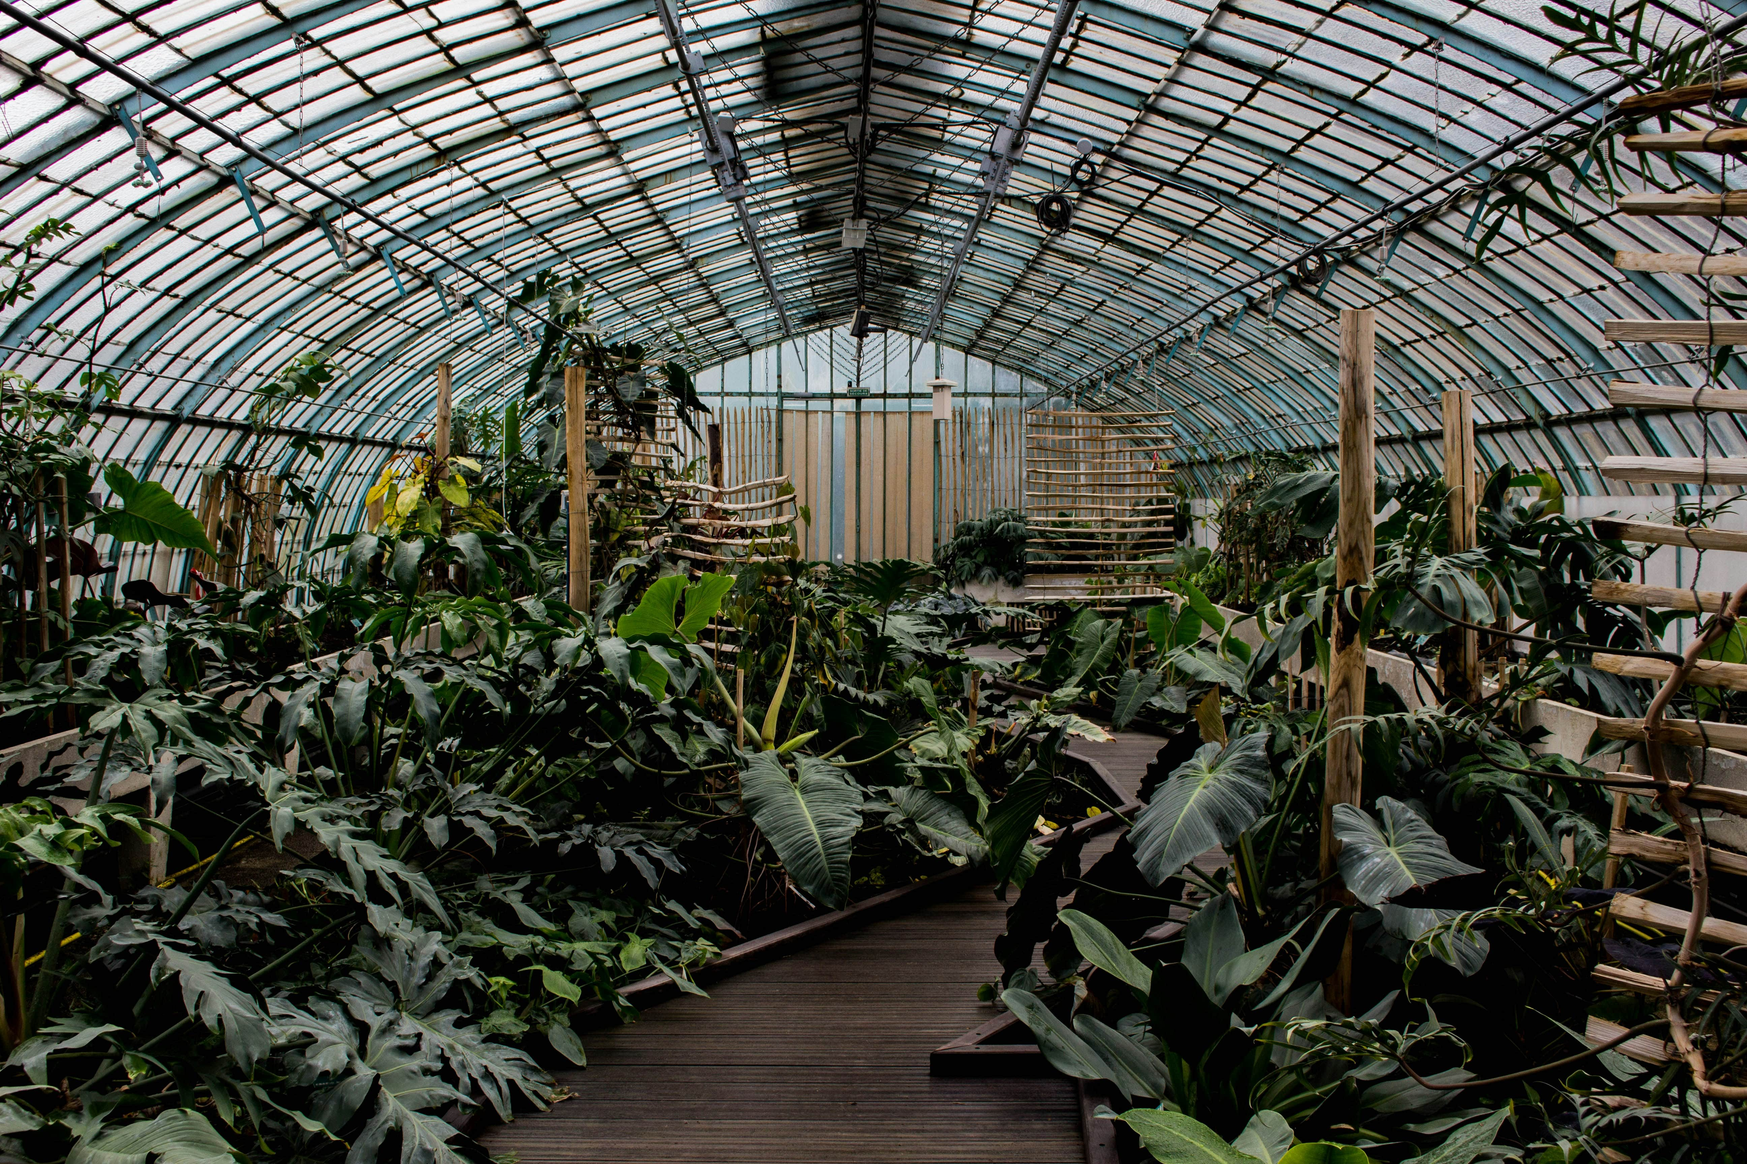
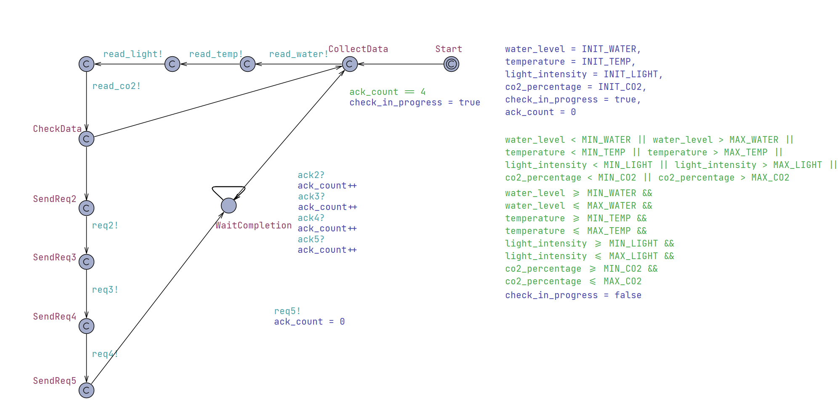
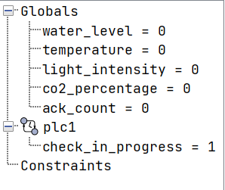
UPAAL Model – Global Setup & PLC1 Workflow
Variables setup : water level, temperature, light intensity, CO₂ percentage
Thresholds:
Water: 30-70
Temperature: 24-28
Light: 400-600
CO₂: 400-700
ack_count : ensures PLC1 receives acknowledgements from PLC2–PLC5 before continuing the cycle
PLC1 (Environment Collector)
Collects Data : reads all sensor values
Checks Data : compares values to thresholds. If out of range → sends request to PLC2–PLC5
Notes:
We first set up the greenhouse environment variables:
Water (30–70), Temperature (24–28), Light (400–600), CO₂ (400–700).
PLC1 (Environment Collector) is the "manager":
It reads all the sensor values (water, temp, light, CO₂).
It then compares them with the thresholds.
If any value is out of range, PLC1 sends a request to the respective PLC (PLC2 = water, PLC3 = temp, PLC4 = light, PLC5 = CO₂).
To ensure the cycle works properly, PLC1 uses an ack_count variable to check acknowledgments from PLC2–PLC5 before moving to the next cycle.

Slide 6

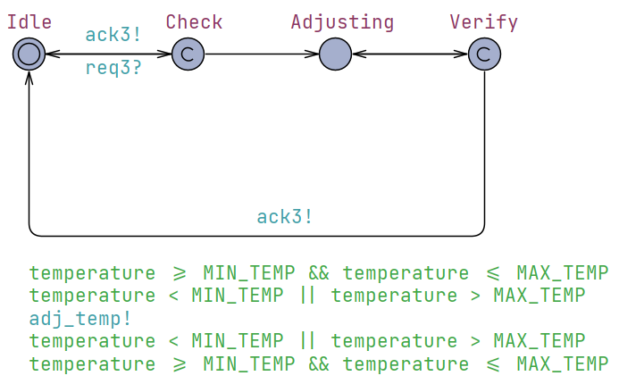
UPAAL Model & Control Flow
PLC3 (Temperature Control)
Idle: waits for a request from PLC1 (req3?)
Check: checks if the value is below or above the threshold
Adjusting: changes temperature to the required threshold by activating actuators
Verify: if the sensors value is in [MIN_TEMP,MAX_TEMP] → ack3! → back to Idle
A similar method is used for all the other plc’s like water, light and co2.
This method is used to bring them into the thresholds and maintain them in the thresholds.
Notes:
Workflow:
Idle – Waits for a signal (req3?) from PLC1.
Check – Sees if temperature is below or above the threshold.
Adjusting – Activates heater/fan to bring temperature back to normal.
Verify – Checks if temperature is now within the correct range.
If yes, it sends ack3! back to PLC1 and goes back to idle.
Each PLC waits for instructions, checks its part (temp, water, etc.), fixes it, and reports back to PLC1.

Slide 7

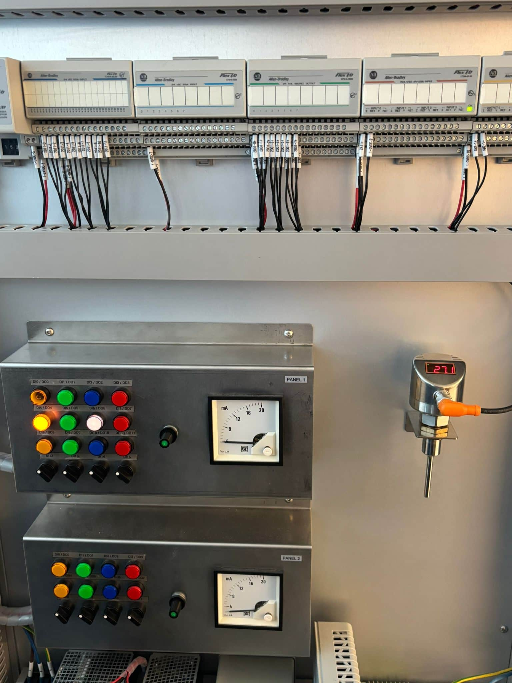
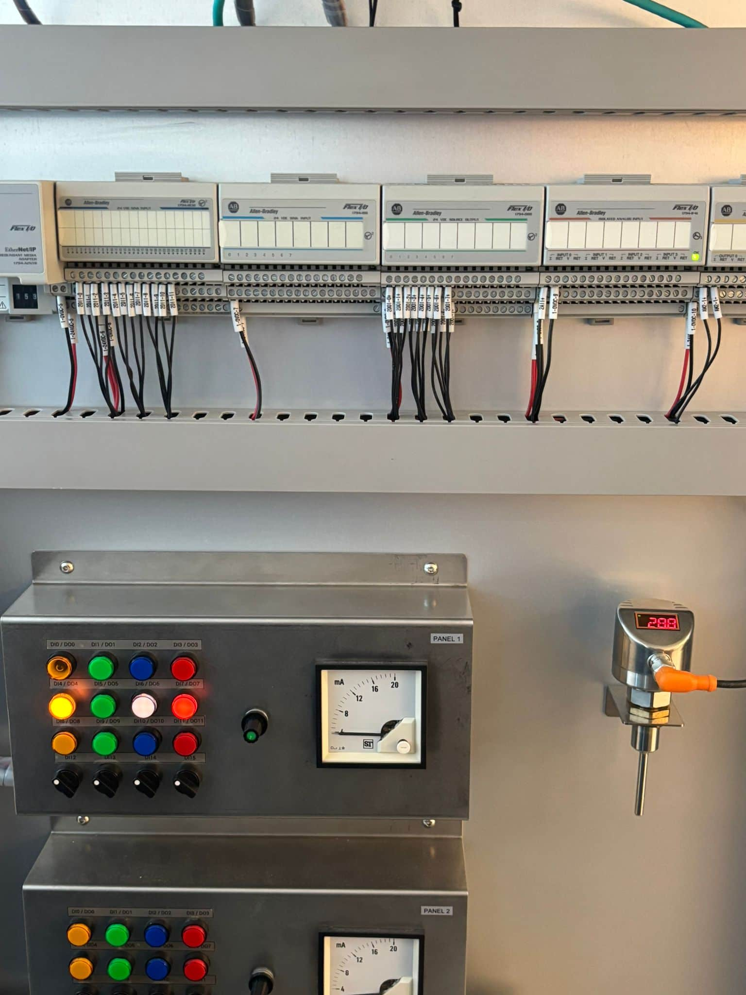
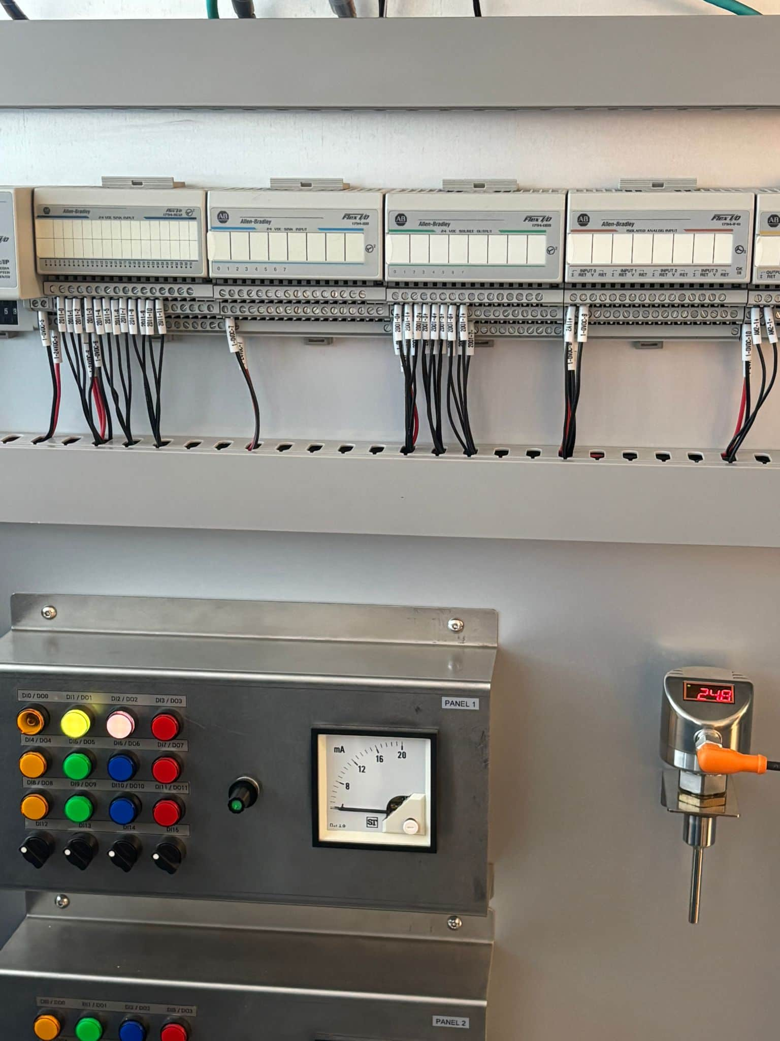
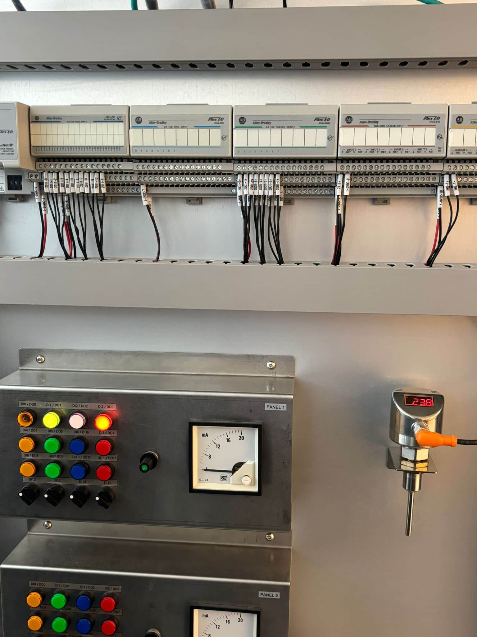
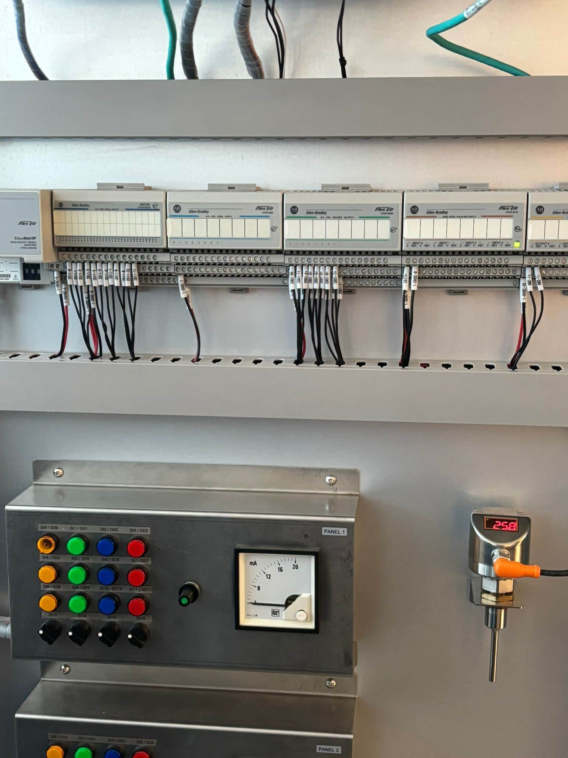
PLC Code Mapping & Execution Cycle
Not working
Not working
The pictures above show the expected flags if the value of temperature is below or above the threshold1&2. First button is for flag and the second is for actuator activated, in this case low power actuator is active.
But in this case 3rd button is also active which mean the temperature is way below or above threshold and gets activated when Eg: < ThresTemp1 – 10 and actives a high- power cooler actuator.
In this case the plc is not flagging anything in the system because the value in temp1 is in the threshold and no action is needed.
Notes:
These pictures show how PLCs respond depending on sensor readings (example: temperature).
Case 1: If the temperature is slightly out of range →
A small flag goes up (warning).
A low-power actuator (like a small cooler/heater) turns on.
Case 2: If the temperature is way out of range →
A stronger actuator (like high-power cooling) gets activated.
Example: if Temp < Threshold - 10, it switches on the high-power actuator.
Case 3: If everything is within thresholds →
The PLC does nothing (idle).

Slide 8

Flow Diagram
End-to-end pipeline:
Sensor simulation → Data logging in InfluxDB → Visualization in Grafana → Control via PySide (SCADA).
Integration:
Python threads manage PLC simulation and data publishing; InfluxDB stores time-series data for analysis.
Visualization & Control:
Grafana provides real-time dashboards, while PySide enables interactive overrides and monitoring.
Python
Main Thread
Visualize in
Grafana dashboard
Thread
Frontend – PySide (SCADA)
Influxdb
query
to render control
Pub/Sub
Simulation
Influx DB
runs in port 8086
Component
The simulation is presented in seconds to simulate hours for faster execution
Runs in localhost and can be containerized
Notes:
Moving to Python
-all individual PLCs built as separate modules
-logic similar to the UPPAAL model, now parallel PLC threads
-high level overview of the system, individual components in detail in coming slides
-PySide all-in-one dashboard, offers

Slide 9

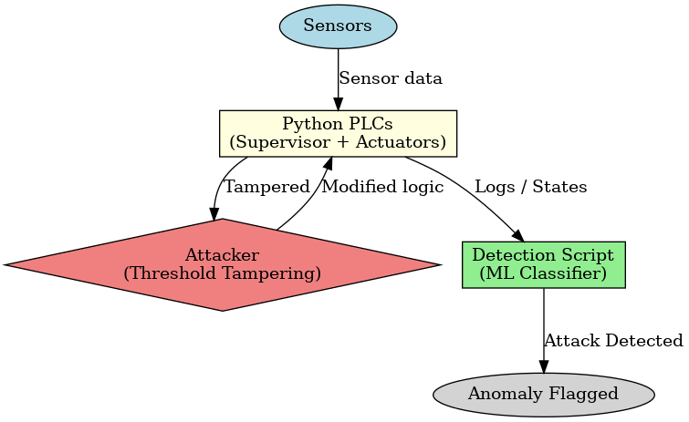
Python Implementation of CPS, Attacks & Detection
Model implemented in Python
All PLCs (controller and individual sensors with their respective actuators) all implemented as python scripts
Unlike UPPAAL, this model does not rely on sequential acknowledgements from each PLC, instead operating on threads
PLC Logic
PLC 2-5 operates on a principle of bringing sensor values under specified threshold
Override functionality is built-in offering an option to control actuator behavior
PLC 1 checks each sensor output, maintains other PLC behavior via threads, and also pushes to InfluxDB

Slide 10
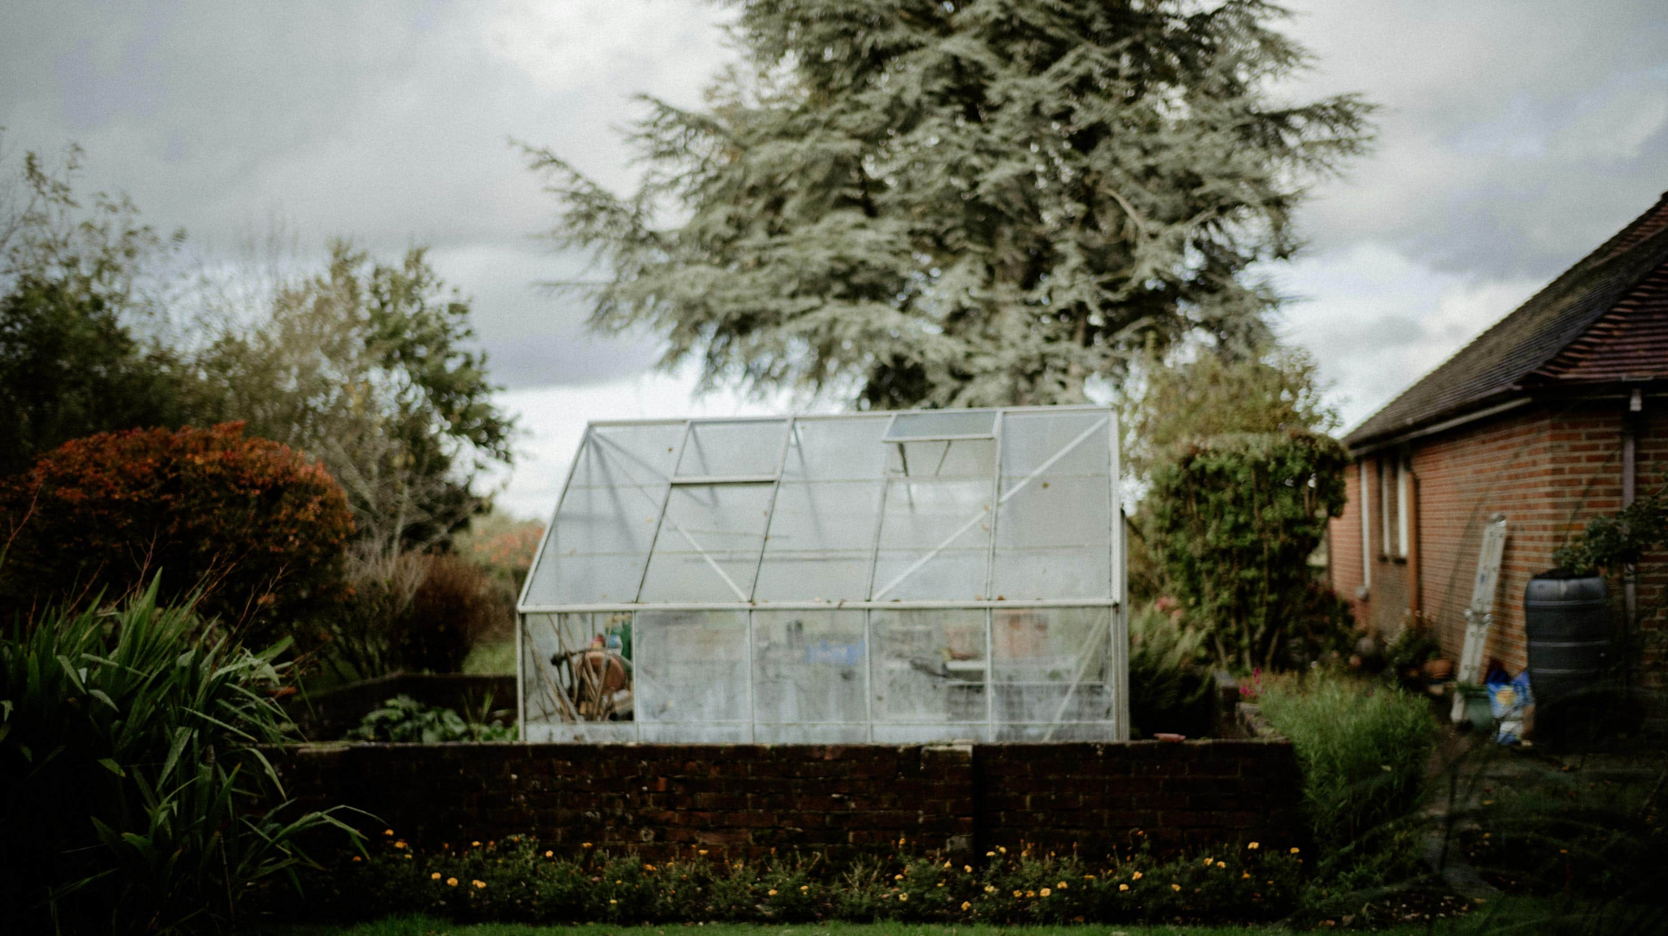
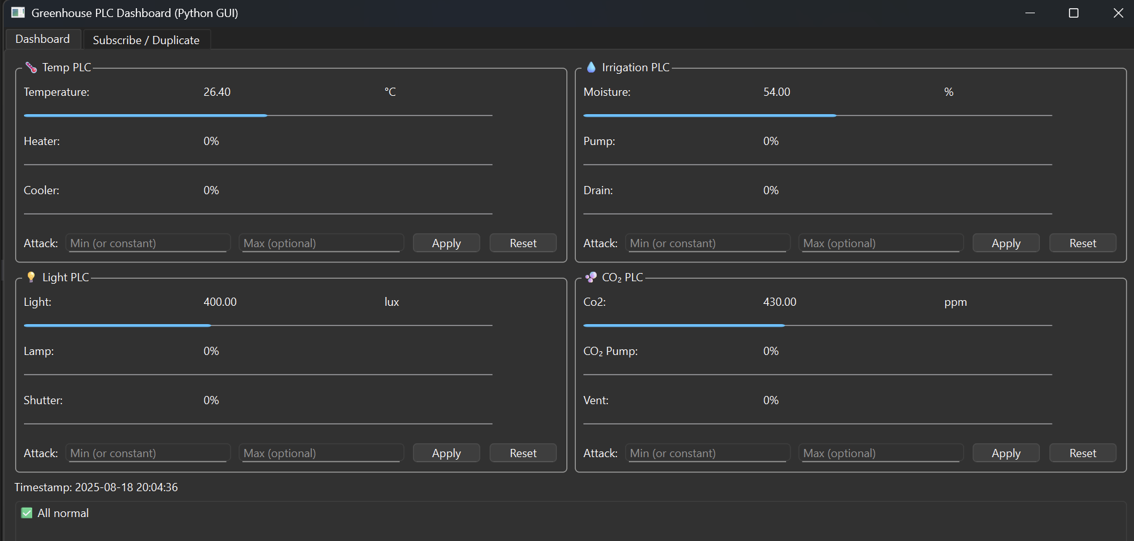
Python Implementation - Frontend
Using PySide, we developed a front-end that provides a SCADA-style interface to monitor the greenhouse system in real time. The dashboard displays key sensor readings and actuator states, giving a clear view of current system performance.
Key Features:
Override Controls – apply fixed values or ranges to test system behavior. These controls are also used to simulate Override Attacks, where false values are forced into the system.
This front-end bridges system operations with monitoring, making it easier to visualize, control, and experiment with the greenhouse environment while also demonstrating how attacks can be carried out and detected.

Slide 11

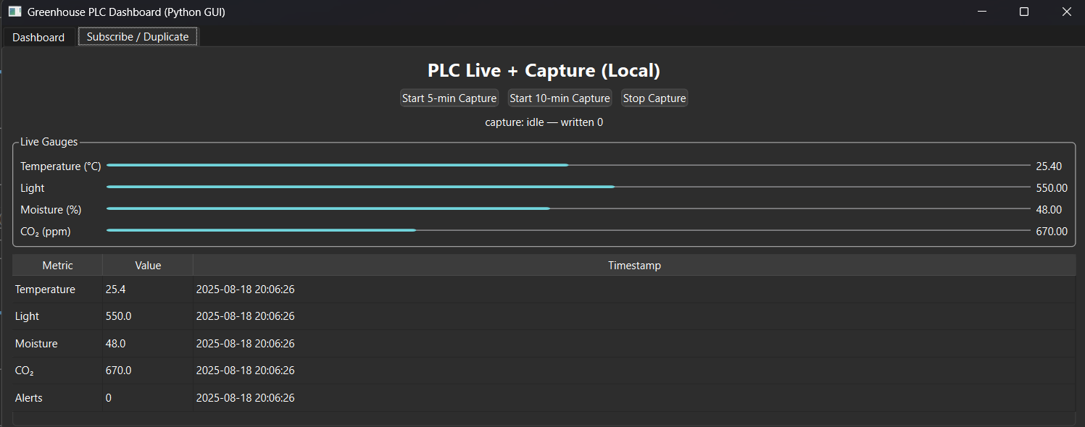
Python Implementation - Frontend
We have a Subscribe/Duplicate tab built into the GUI, functioning like a “recording button.” Rather than creating a new network feed, it listens to the live data stream from the collector.
Users can open a 5-minute or 10-minute capture window, during which all incoming sensor and actuator packets are duplicated into a separate InfluxDB measurement (e.g., greenhouse_room_2). This creates a labeled dataset for training or demos without affecting the main live feed.
The approach keeps the system safe and simple: no extra ports or external tools are needed—just duplication of the existing live packets.

Slide 12

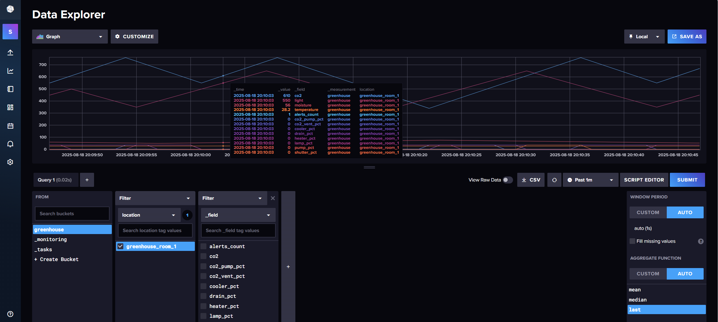
Python Implementation – InfluxDB
The greenhouse system streams sensor and actuator data through a real-time InfluxDB pipeline. Each Python PLC (Temperature, Light, Moisture, CO₂) generates readings every second, which are collected by plc1_collector.py. The collector merges these into a single packet and attaches alerts for threshold violations.
These packets are pushed to InfluxDB at high frequency, tagged by location (e.g., greenhouse_room_1) and including all sensor, actuator, and alert fields. Grafana reads directly from InfluxDB to provide live dashboards and historical analysis.
For demonstrations or machine learning, the PySide GUI can duplicate the live stream into a separate measurement (e.g., greenhouse_room_2) for short 5–10 minutes session, creating labeled datasets without interrupting the main feed.

Slide 13

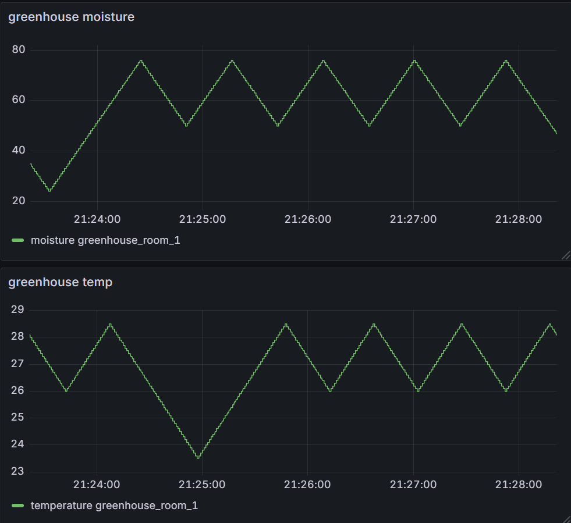
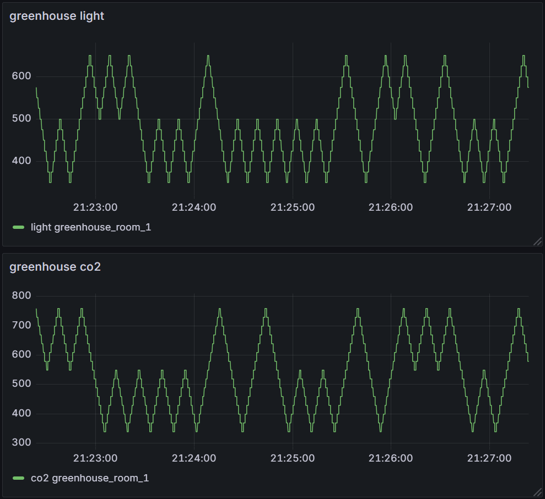
Python Implementation – Grafana
Grafana is used to monitor and visualize the greenhouse system in real time, connecting directly to InfluxDB as its data source. It pulls sensor and actuator data including temperature, light, moisture, CO₂, and alerts and supports filtering by location tags for individual greenhouses.
The dashboards provide:
Line charts to track continuous sensor readings
Gauges showing actuator duty cycles
Alerts panel highlighting threshold breaches
When Attacks are applied via the PySide front-end, Grafana instantly reflects the impact: sensor readings drift outside safe limits, actuator outputs spike, and alerts update in real time. The dashboards can also be used for operator monitoring, reporting, and exporting data for further analysis or machine learning applications.

Slide 14

Attack Methodology
Scenario:
Attacker attempts to override sensor output values being transmitted to Monitoring System (InfluxDB)
Objectives:
Evade Detection
The monitoring system receives the altered sensor data.
Misleading Actuation
Actuators then react to the incorrect sensor data to compensate
This can introduce abnormal behaviour to system as a result.
Cause Damage
Allow plants to overheat (or freeze) long enough to induce stress or crop failure
Overheating crops → reduced yield
Hidden equipment strain (overheat)
Python
Visualize in
Grafana dashboard
Frontend – PySide (SCADA)
Main Thread
to render control
Influxdb
query
Thread
Influx DB
runs in port 8086
Pub/Sub
Simulation
Attacker attacks the render control
Component
The simulation is presented in seconds to simulate hours for faster execution
Runs in localhost and can be containerized
Notes:
Attack method here – override the sensor output values that are being transmitted to InfluxDB from the front-end
Wrong sensor data received, actuators react incorrectly
Abnormal behaviour is introduced into the system
If targeted correctly can cause significant damages to plants, crops etc

Slide 15

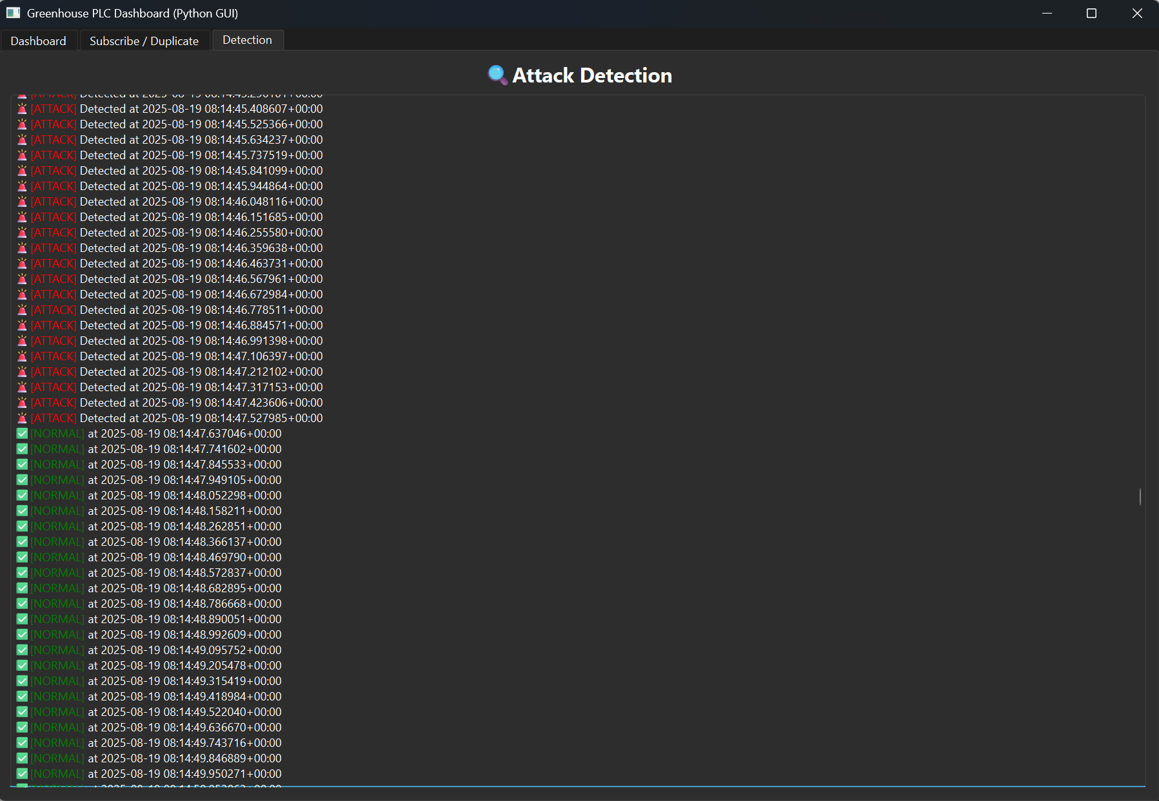
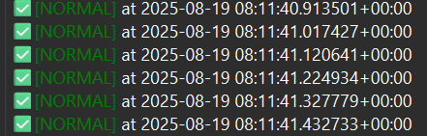
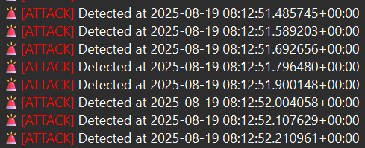
Detection Mechanism
We built a dataset off of our system’s sensor outputs and used it to train an ML-based classification system
Both Normal and Attack scenarios were used to build dataset
Using Decision Tree method with 80-20 Train/Test split
Reads sensor output values in real-time
Receive alerts on normal or attack behavior.
Using the same train/test split, we computed the following performance metrics:
Overall accuracy: 99.8013%
Normal scenarios were correctly identified with 100% accuracy, only 3 False Negatives cropped up during Attack Detection.
ROC area is 0.999, confirming strong distinction between attack and normal behavior
Actual / Predicted | Class 0 (Normal) | Class 1 (Attack)
Class 0 (Normal) | 743 (True Negative) | 0 (False Positive)
Class 1 (Attack) | 3 (False Negative) | 764 (True Positive)
Notes:
Built a dataset of sensor outputs both normal and attack behavior
Model trained using Decision Tree method with 80/20 split
Offers realtime alerts
Computed model metrics
Observed 99.8% accuracy
3 FN identified
Based on ROC, we have clear distinction between attack and normal

Slide 16
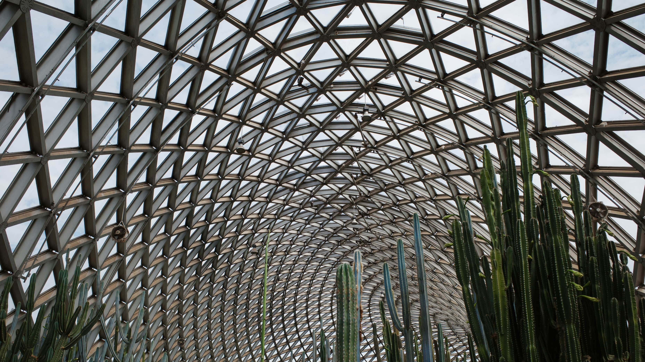
Conclusions
Main Outcomes:
Built a digital greenhouse environment using Python, PySide, InfluxDB and Grafana to simulate and monitor control processes via a SCADA system
Developed an interactive GUI in PySide to control, override, and observe system responses.
Visualized sensor behavior and attack traces in Grafana, enabling transparent monitoring and validation.
Using the override functions built in as an attack method to induce abnormal behavior in the system.
Built a detection pipeline integrating machine learning with real-time sensor data for attack pattern detection.
Notes:
Some of our main outcomes
-digital greenhouse environment built
-Interactive GUI to control, override, and receive alerts
-visualized system behaviour in Grafana
-Attack method using override functionality
-Detection pipeline using ML for attack pattern detection

Slide 17

Conclusions
Key Findings & Observations:
We were able to create a viable digital twin and simulate all the components of the system accurately
With the attack, we were able to show how malicious overrides and spoofed data can compromise system integrity.
Through our detection mechanism, we were able to identify attack patterns in real-time with good accuracy.
Detection Performance:
Detection achieved very high precision and minimal false positives, ensuring reliability in distinguishing normal vs. attack states.
Fast inference and low detection latency, suitable for real-time monitoring.
The system proved resilient to noisy data and spoofed sensor streams.
Notes:
Key Findings & Observations:
-Digital twin was able to showcase all our subsystems accurately in realtime
-Demoed how the attack method works through the override function
-Detection mechanism able to identify attacks with high accuracy in realtime

Slide 18

Questions?

Slide 19


